Slide 1
HTML (Hyper Text Markup Language)
Introduction Part I

Slide 2
What is HTML?
HTML is a markup language for describing web documents (web pages).
HTML stands for Hyper Text Markup Language
A markup language is a set of markup tags
HTML documents are described by HTML tags
Each HTML tag describes different document content

Slide 3
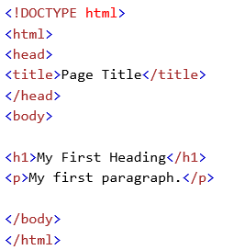
HTML Example

Slide 4
Example Explained
The DOCTYPE declaration defines the document type to be HTML
The text between <html> and </html> describes an HTML document
The text between <head> and </head> provides information about the document
The text between <title> and </title> provides a title for the document
The text between <body> and </body> describes the visible page content
The text between <h1> and </h1> describes a heading
The text between <p> and </p> describes a paragraph

Slide 5

HTML Tags
HTML tags are keywords (tag names) surrounded by angle brackets:
HTML tags normally come in pairs like <p> and </p>
The first tag in a pair is the start tag, the second tag is the end tag
The end tag is written like the start tag, but with a slash before the tag name
The start tag is often called the opening tag. The end tag is often called the closing tag.

Slide 6
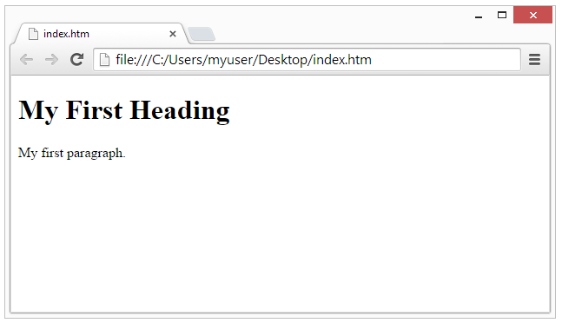
Web Browser
The purpose of a web browser (Chrome, IE, Firefox, Safari) is to read HTML documents and display them.
The browser does not display the HTML tags, but uses them to determine how to display the document:

Slide 7
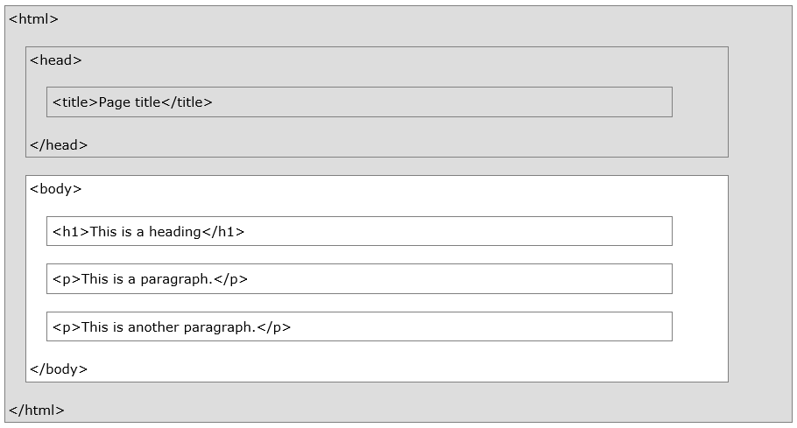
HTML Page Structure
Only the <body> area (the white area) is displayed by the browser.

Slide 8
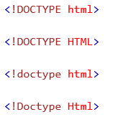
The <!DOCTYPE> Declaration
The <!DOCTYPE> declaration helps the browser to display a web page correctly.
There are different document types on the web.
To display a document correctly, the browser must know both type and version.
The doctype declaration is not case sensitive. All cases are acceptable:

Slide 9
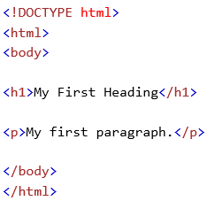
HTML Documents
All HTML documents must start with a type declaration: <!DOCTYPE html>.
The HTML document itself begins with <html> and ends with </html>.
The visible part of the HTML document is between <body> and </body>.

Slide 10
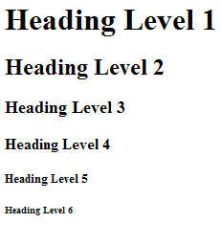

HTML Headings
HTML headings are defined with the <h1> to <h6> tags:

Slide 11
HTML Headings
Headings are defined with the <h1> to <h6> tags.
<h1> defines the most important heading. <h6> defines the least important heading.
Search engines use your headings to index the structure and content of your web pages.
Users skim your pages by its headings. It is important to use headings to show the document structure.
h1 headings should be main headings, followed by h2 headings, then the less important h3, and so on.

Slide 12

HTML Paragraphs
HTML paragraphs are defined with the <p> tag:
Groups sentences and sections of text together.
Block Display – Configures empty space above and below

Slide 13
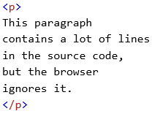
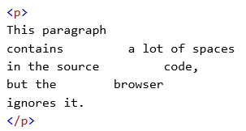
HTML Paragraphs
The HTML <p> element defines a paragraph.
The browser will remove extra spaces and extra lines when the page is displayed.
Any number of spaces, and any number of new lines, count as only one space.

Slide 14
HTML Line Breaks
The HTML <br> element defines a line break.
Use <br> if you want a line break (a new line) without starting a new paragraph:

Slide 15
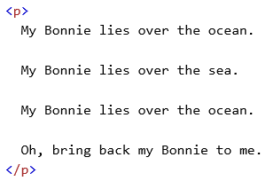
The Poem Problem
This poem will display as one line:

Slide 16
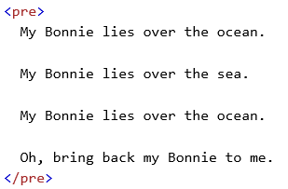
The HTML <pre> Element
The HTML <pre> element defines preformatted text.
The text inside a <pre> element is displayed in a fixed-width font (usually Courier), and it preserves both spaces and line breaks:

Slide 17
Line Break Element
Line Break element
Stand-alone, or void tag
…text goes here <br> This starts on a new line….
Causes the next element or text to display on a new line

Slide 18
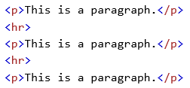
HTML Horizontal Rules
The <hr> tag creates a horizontal line in an HTML page.
The hr element can be used to separate content:

Slide 19
Blockquote Element
Blockquote element
Indents a block of text for special emphasis
<blockquote>
…text goes here…
</blockquote>
Block Display – Configures empty space above and below
19

Slide 20


HTML Elements
HTML elements are written with a start tag, with an end tag, with the content in between:
The HTML element is everything from the start tag to the end tag:

Slide 21
Nested HTML Elements
HTML elements can be nested (elements can contain elements).
All HTML documents consist of nested HTML elements.
This example contains 4 HTML elements:

Slide 22
Phrase Elements
Indicate the context and meaning of the text
Element | Example | Usage
<b> | bold text | Text that has no extra importance but is styled in bold font by usage and convention
<em> | emphasized text | Causes text to be emphasized in relation to other text; usually displayed in italics
<i> | italicized text | Text that has no extra importance but is styled in italics by usage and convention
<mark> | mark text | Text that is highlighted in order to be easily referenced (HTML5 only)
<small> | small text | Legal disclaimers and notices (“fine print”) displayed in small font-size
<strong> | strong text | Strong importance; causes text to stand out from surrounding text; usually displayed in bold
<sub> | _{sub} text | Displays a subscript as small text below the baseline
<sup> | ^{sup} text | Displays a superscript as small text above the baseline

Slide 23
Proper Nesting
CODE:
<p><i>Call for a free quote for your web development needs: <strong>888.555.5555 </strong></i></p>
BROWSER DISPLAY:
Call for a free quote for your web development needs: 888.555.5555

Slide 24
Exercises
<!DOCTYPE html>
<html>
<body>
<p>London is the capital city of England. It is the most populous city in the United Kingdom, with a metropolitan area of over 13 million inhabitants.</p>
</body>
</html>
1- Add Heading before the paragraph
2- Add horizontal rule between heading and paragraph.
3-Add six headings to the document with the text "Hello".
4- Mark up the following text with appropriate tags: "Universal Studios Presents" is the most important content. "Jurassic Park" is the next most important content. "About" is of lesser importance than Jurassic Park. The last sentence is just a paragraph.

Slide 25
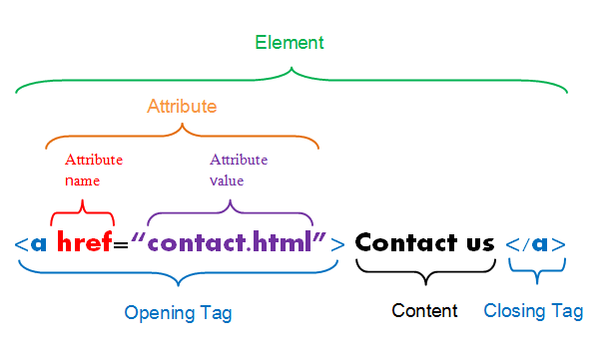
HTML Links
HTML links are defined with the <a> tag:

Slide 26
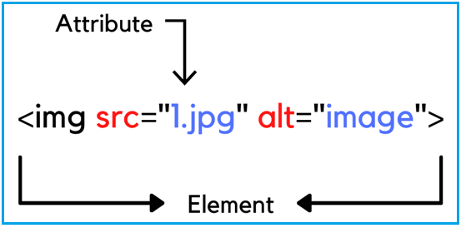
HTML Images
HTML images are defined with the <img> tag.
The source file (src), alternative text (alt), and size (width and height) are provided as attributes:

Slide 27
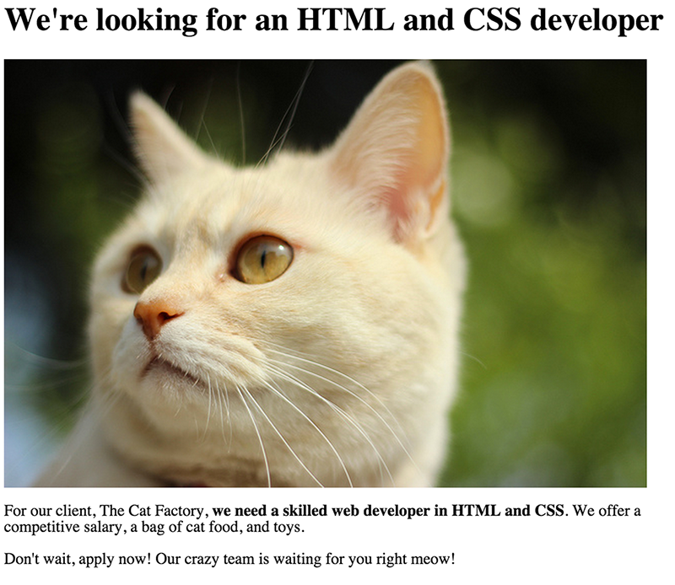
Exercise
Lets do this!

Slide 28
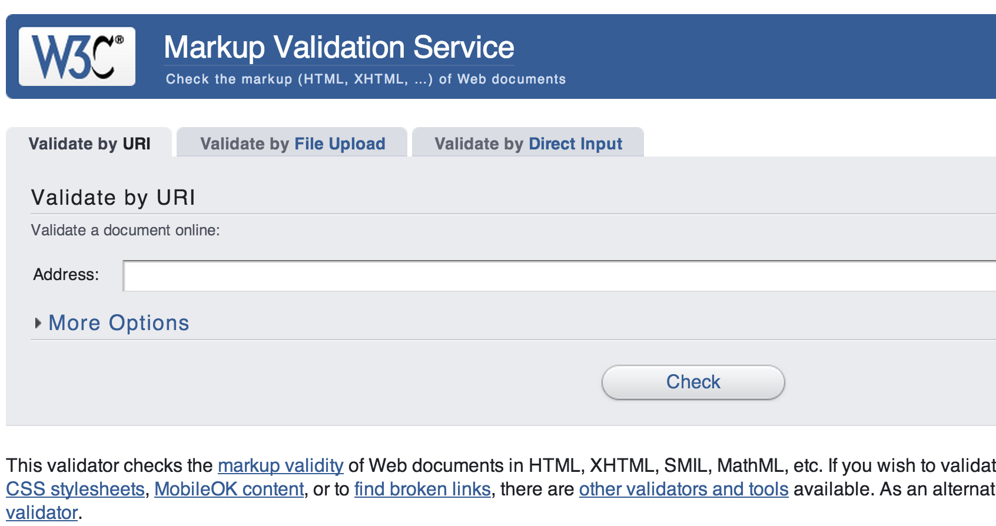
Validate your code!
http://validator.w3.org/

Slide 29
HTML Lists
Unordered List
Ordered List
Description List formerly called a definition list

Slide 30
HTML List Tags
Tag | Description
<ul> | Defines an unordered list
<ol> | Defines an ordered list
<li> | Defines a list item
<dl> | Defines a description list
<dt> | Defines a term in a description list
<dd> | Describes the term in a description list

Slide 31
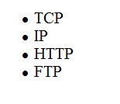
Unordered List
Displays a bullet, or list marker, before each entry in the list.
<ul> Contains the unordered list
<li> Contains an item in the list

Slide 32
Unordered List Example
<ul>
<li>TCP</li>
<li>IP</li>
<li>HTTP</li>
<li>FTP</li>
</ul>

Slide 33
Ordered List
Displays a numbering or lettering system to itemize the information contained in the list
<ol> Contains the ordered list
type attribute determines numbering scheme of list, default is numerals
<li> Contains an item in the list

Slide 34
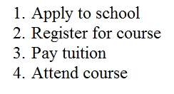
Ordered List Example
<ol>
<li>Apply to school</li>
<li>Register for course</li>
<li>Pay tuition</li>
<li>Attend course</li>
</ol>

Slide 35
Description List
Useful to display a list of terms and descriptions or a list of FAQ and answers
<dl> Contains the description list
<dt> Contains a term/phrase/sentence Configures empty space above and below the text
<dd> Contains a description of the term/phrase/sentence
Indents the text
Configures empty space above and below the text

Slide 36
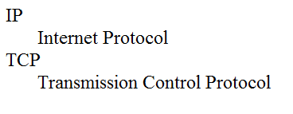
Description List Example
<dl>
<dt>IP</dt>
<dd>Internet Protocol</dd>
<dt>TCP</dt>
<dd>Transmission Control Protocol</dd>
</dl>

Slide 37
Ordered HTML List - The Type Attribute
The type attribute of the <ol> tag, defines the type of the list item marker:
Type | Description
type="1" | The list items will be numbered with numbers (default)
type="A" | The list items will be numbered with uppercase letters
type="a" | The list items will be numbered with lowercase letters
type="I" | The list items will be numbered with uppercase roman numbers
type="i" | The list items will be numbered with lowercase roman numbers

Slide 38
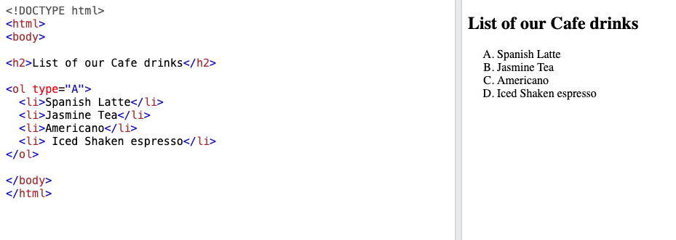
Ordered List - Example

Slide 39
Special Characters
Display special characters such as quotes, copyright symbol, etc.
Character Code
© &copy;
< &lt;
> &gt;
& &amp;
&nbsp;

Slide 40
Div Element
Configures a structural block area or “division” on a web page with empty space above and below.
Can contain other block display elements, including other div elements
<div>Home Services Contact</div>

Slide 41
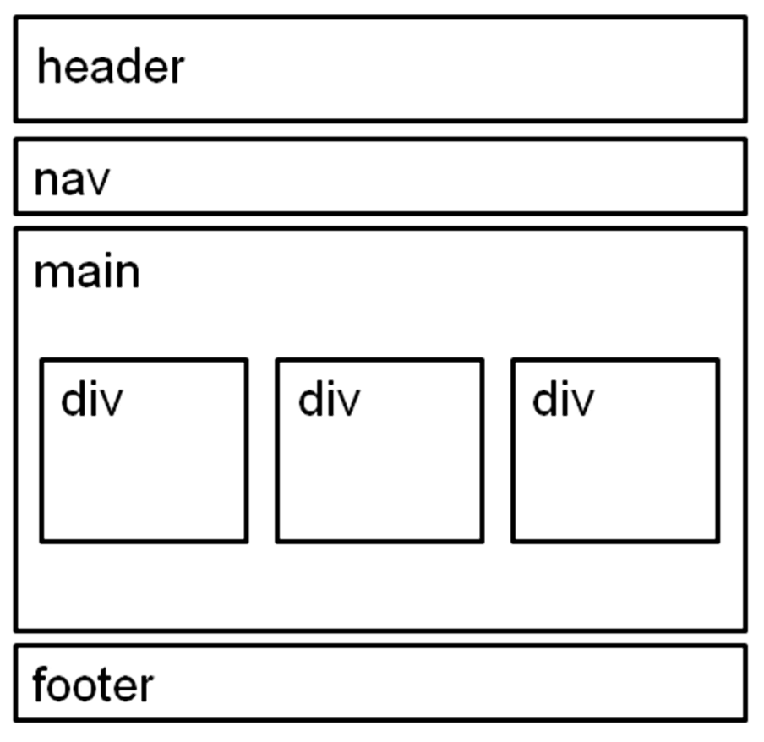
HTML5 Structural Elements
header Element
<header></header> Contains the web page document’s headings
nav Element
<nav></nav> Contains web page document’s main navigation
main Element <main></main> Contains the web page document’s main content
footer Element
<footer></footer> Contains the web page document’s footer

Slide 42
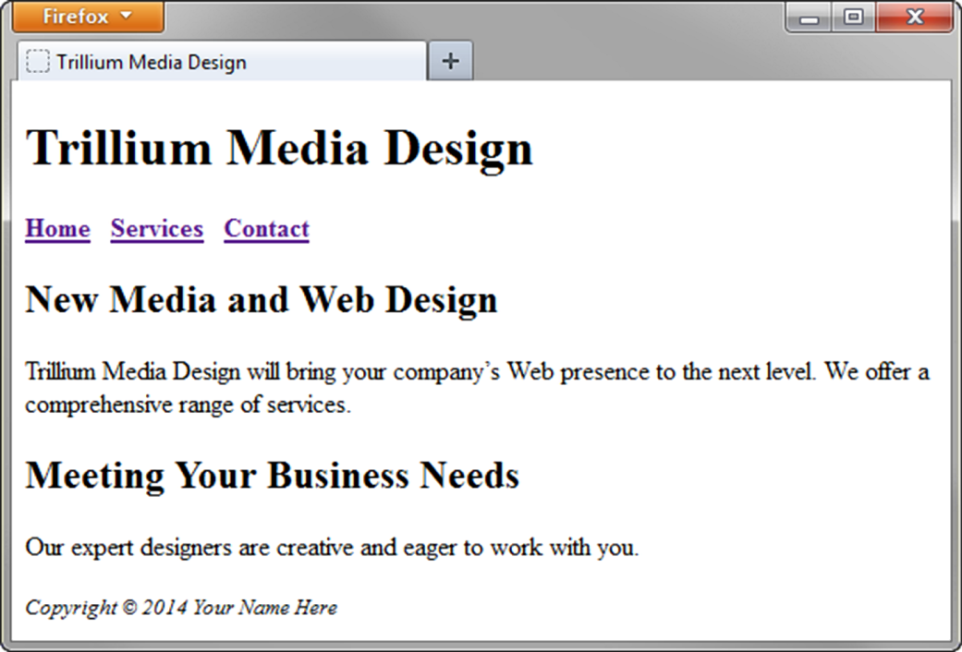
HTML5 Structural Elements
<body>
<header> document headings go here </header>
<nav> main navigation goes here </nav>
<main> main content goes here </main>
<footer> document footer information goes here </footer>
</body>

Slide 43
Anchor Element
Specifies a hyperlink reference (href) to a file
Text between the <a> and </a> is displayed on the web page.
<a href="contact.html">Contact Us</a>
href Attribute
Indicates the file name or URL

Slide 44
Absolute & Relative Hyperlinks
Absolute link
Link to a different website
<a href="http://yahoo.com">Yahoo</a>
Relative link
Link to pages on your own site
<a href="index.htm">Home</a>

Slide 45
E-Mail Hyperlink
Automatically launch the default mail program configured for the browser
If no browser default is configured,
a message is displayed
<a href=“mailto:me@gmail.com”>me@gmail.com</a>

Slide 46
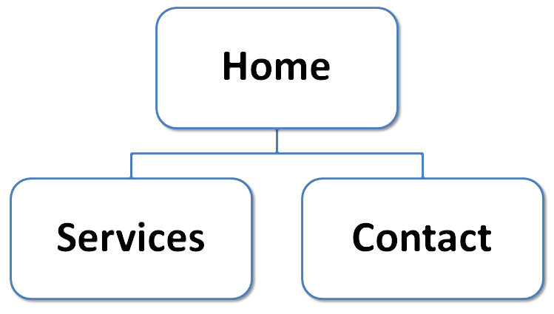
Hyperlinks
Hands-On Practice

Slide 47
Exercise!

